Slide 1
DATA 606 Capstone Project
Part 1 ~ by Carlotta Amaduzzi camaduz1@umbc.edu
as of February 27, 2022

Slide 2

Overview
Access to Higher Education is essential
to maintain a more equitable society
to inspire individual professional and financial growth
to ensure social mobility
Understanding the factors that influence undergraduate enrollment in Higher Education Institutions (HEIs) can have a double positive effect:
on the HEIs themselves which are for all practical purposes fairly large (business) organizations
on the impact increased levels of education can have on society as a whole

Slide 3

Research Focus
The questions I am interested in looking into are the following:
Based on publicly reported information regarding HEIs, what features seem to affect student enrollment choice the most?
With an eye to I.D.E.A. (Inclusion, Diversity, Equity, and Access), do HEIs with different structural characteristics, fare differently across the US?
Are new policies adopted by HEIs, such as standardized-tests-blind admission policies, having an effect on students’ enrollment?

Slide 4
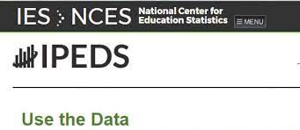
The Data
The data initially used for this project is all publicly available information
The data was downloaded from the Integrated Postsecondary Education Data System (IPEDS) web site (https://nces.ed.gov/ipeds/datacenter/DataFiles.aspx )
It refers to different files of data relative to HEIs
Institutional ID data
Institutions Offerings
Students’ Enrollment data
Admissions’ Policies
Focus was placed exclusively on data directly reported by the HEIs themselves

Slide 5

Data Cleaning
During this initial phase of data cleaning primary focus has been placed on acquiring a sound sub-set of HEIs for which up-to-date data was available for the 2019-2020 academic year.
Dictionary files accompanying each datafile have been extensively used to identify the salient features retained for the analysis and to understand the reported data
The short-list of institutions selected will be used to complete a comparative analysis across time, if possible

Slide 6
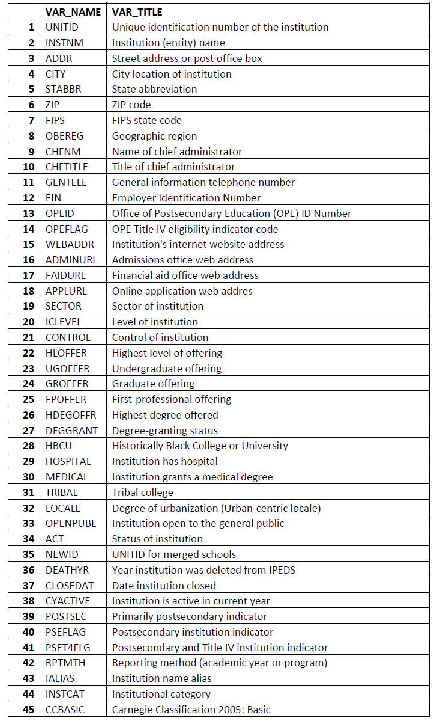
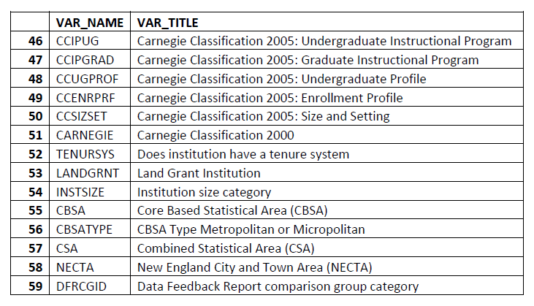
Institutional Descriptive data
Data File: hd2020.csv
Dictionary: hd2020.xls
The data file contains 59 different variables that help unequivocally identify each HEI
Final Selected features: (after data cleaning)
'UNITID’,
'INSTNM’
'STABBR’
'OBEREG’
'HLOFFER’
'GROFFER’
'HDEGOFFR’
'HBCU’
'LOCALE’
'POSTSEC’
'INSTCAT’
'INSTSIZE'

Slide 7
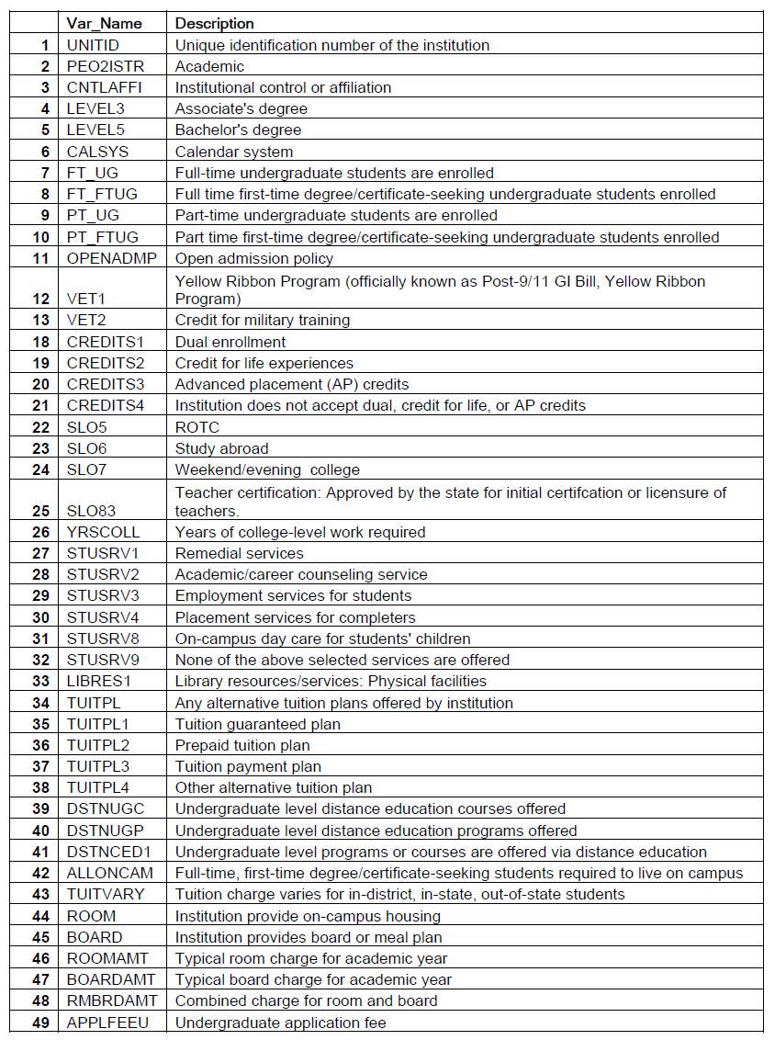
Services Offered Descriptive data
Data File: ic2020.csv
Dictionary: ic2020.xls
The data file contains 49 different variables that offer information regarding HEIs services offerings
Final Selected features: (after data cleaning)
'UNITID’
'CNTLAFFI’
'LEVEL3’
'LEVEL5’
'CALSYS’
'FT_UG’
'FT_FTUG’
'PT_UG’
'PT_FTUG’
'OPENADMP’
'VET1’
'VET2’
'CREDITS1’
'CREDITS2’
'CREDITS3’
'CREDITS4’
'SLO5‘
’SLO6’
'SLO7’
'SLO83’
'YRSCOLL’
'STUSRV1’
'STUSRV2’
'STUSRV3’
'STUSRV4’
'STUSRV8’
'STUSRV9’
'LIBRES1’
'TUITPL’
'TUITPL1’
'TUITPL2’
'TUITPL3’
'TUITPL4’
'DSTNUGC’
'DSTNUGP’
'DSTNCED1’
'ALLONCAM’
'TUITVARY’
'ROOM’
'BOARD’
'APPLFEEU’
'RMANDBRDAMT'

Slide 8
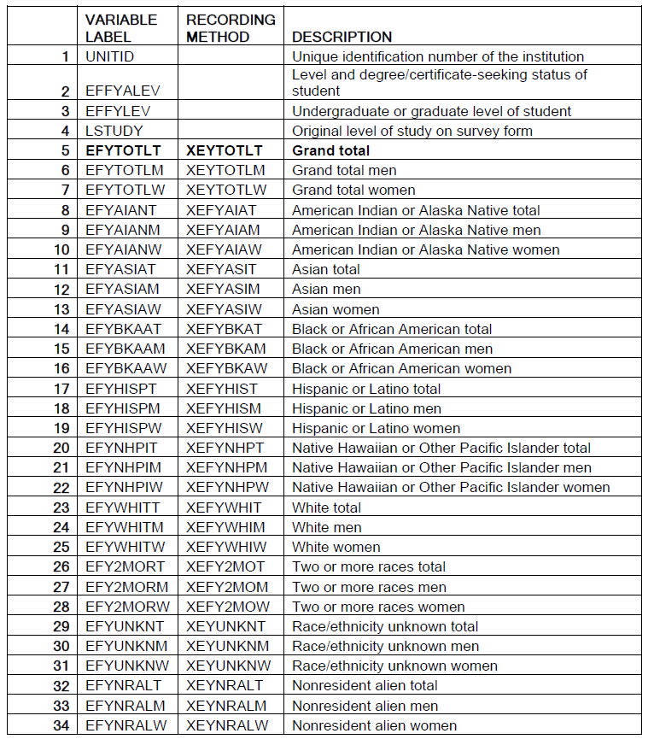
Student Enrollment data
Data File: effy2020.csv
Dictionary: effy2020.xls
The data file contains 34 different variables that offer information regarding HEIs students (not including 30 Imputation Variables)
'UNITID’
'EFYTOTLT’
'EFYTOTLM’
'EFYTOTLW’
'EFYAIANT’
'EFYAIANM’
'EFYAIANW’
'EFYASIAT’
'EFYASIAM’
'EFYASIAW’
'EFYBKAAT’
'EFYBKAAM',
'EFYBKAAW’
'EFYHISPT’
'EFYHISPM’
'EFYHISPW’
'EFYNHPIT’
'EFYNHPIM',
'EFYNHPIW’
'EFYWHITT’
'EFYWHITM’
'EFYWHITW’
'EFY2MORT’
'EFY2MORM’
'EFY2MORW’
'EFYUNKNT’
'EFYUNKNM’
'EFYUNKNW’
'EFYNRALT’
'EFYNRALM’
'EFYNRALW'

Slide 9

Current Status of the data
The files have been merged and the data cleansed
The institutions shortlisted are over 3500
The data refers to 59 US States & Territories
The current data refers only to 2019-2020
65 Variables are currently still being examined

Slide 10
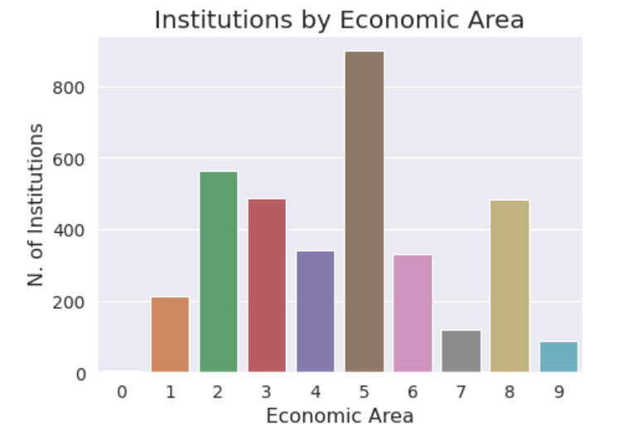
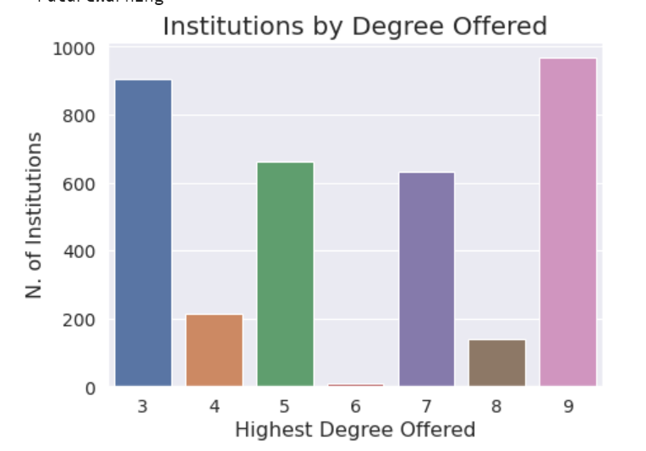
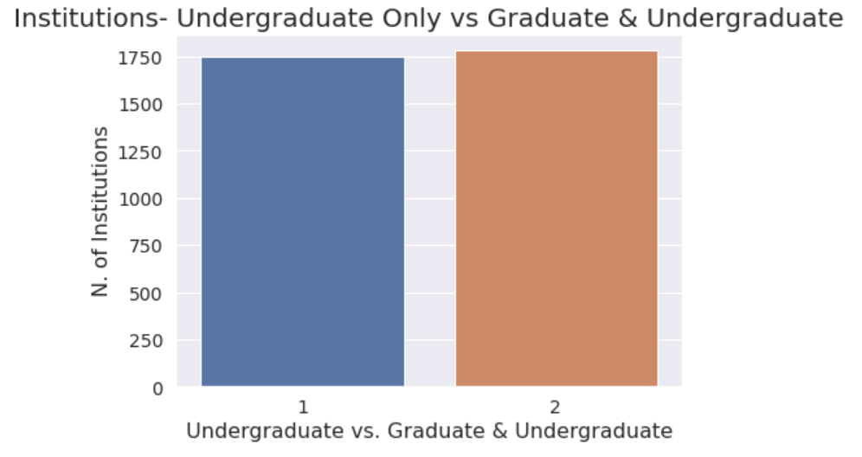
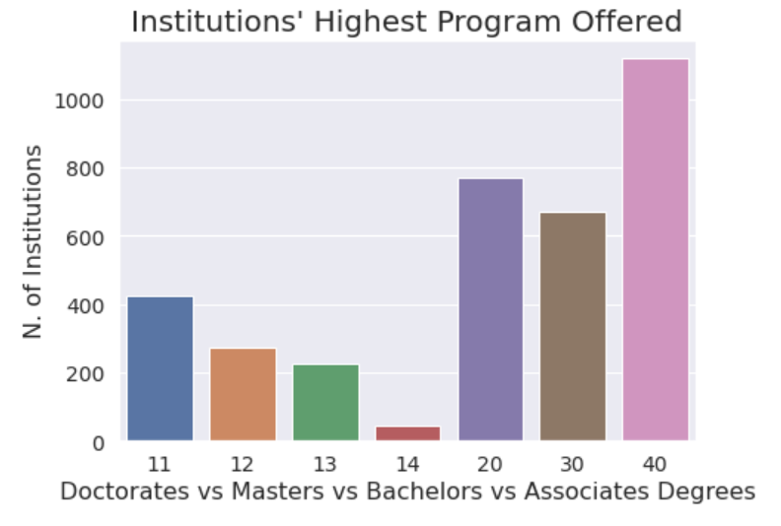

Slide 11
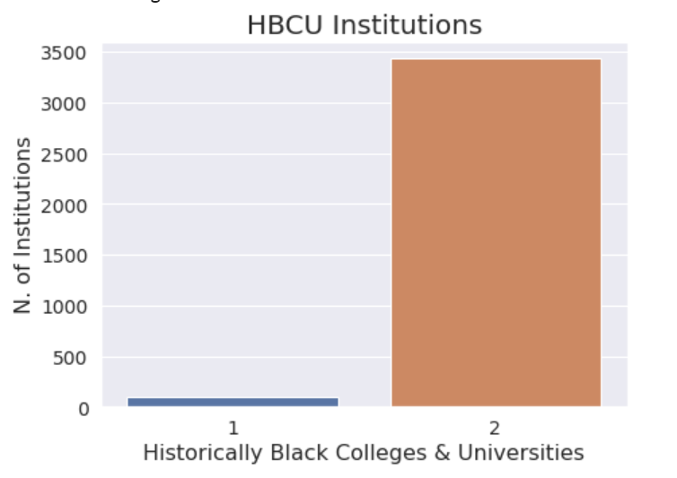
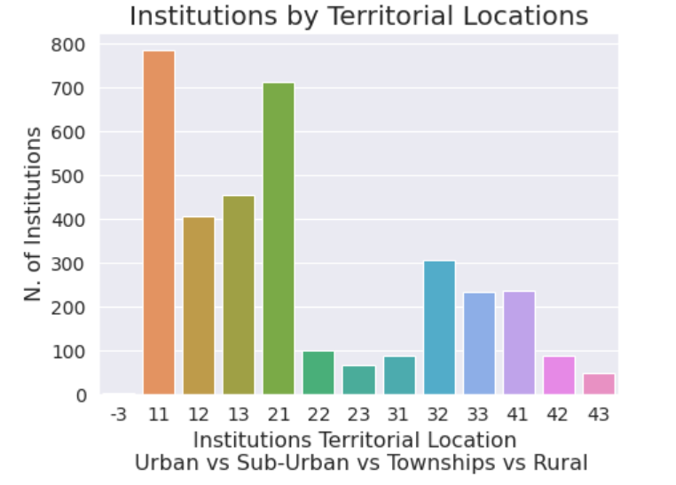
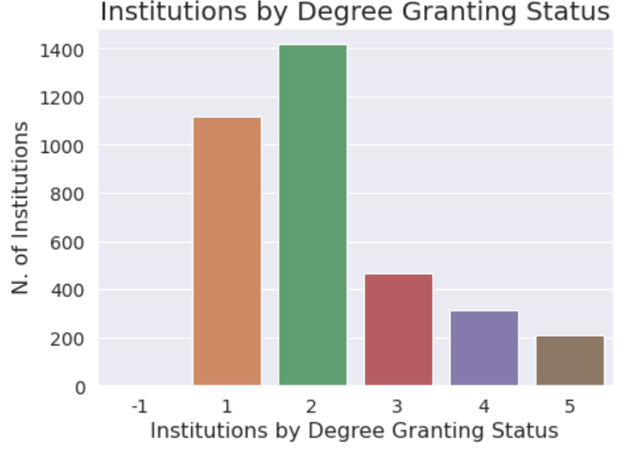
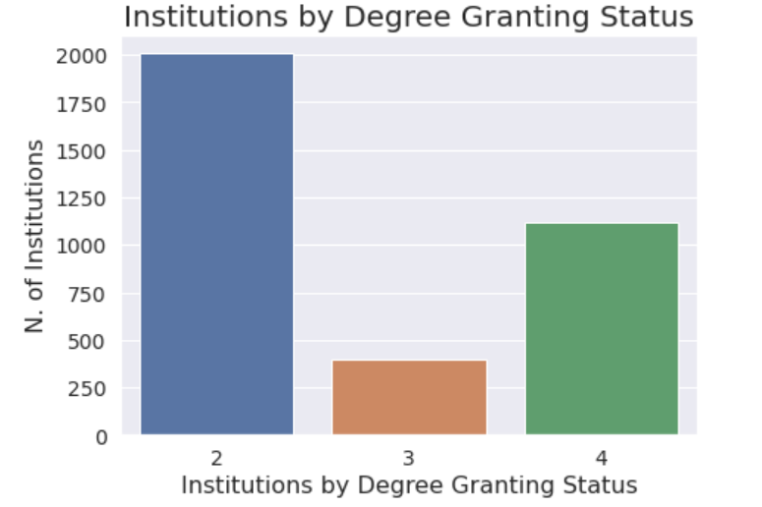

Slide 12
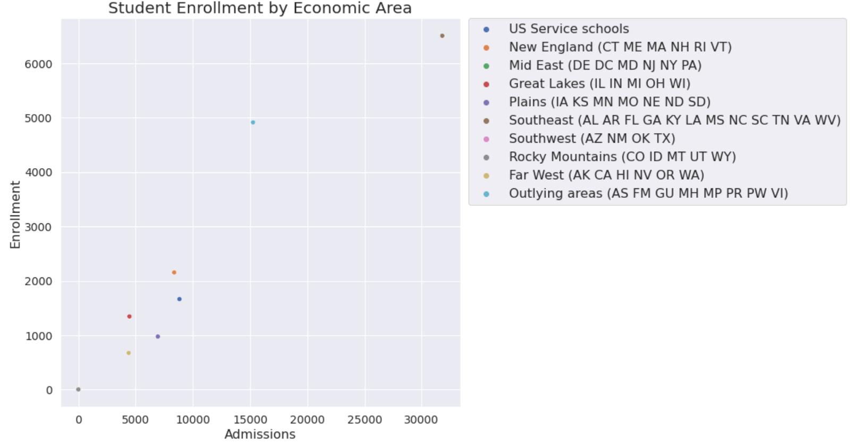
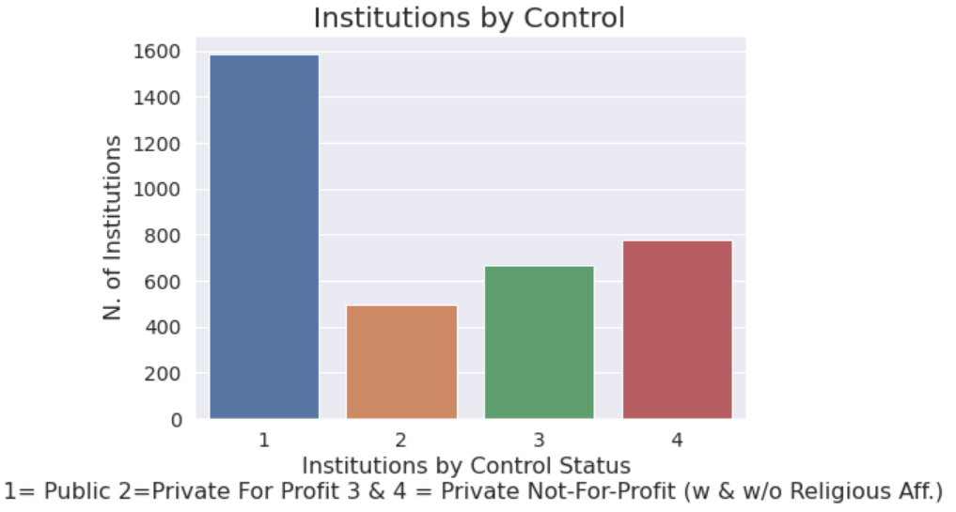

Slide 13
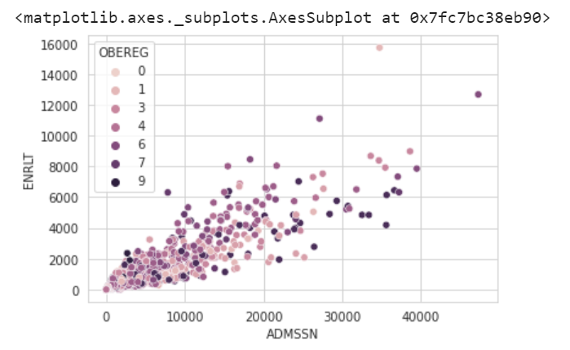
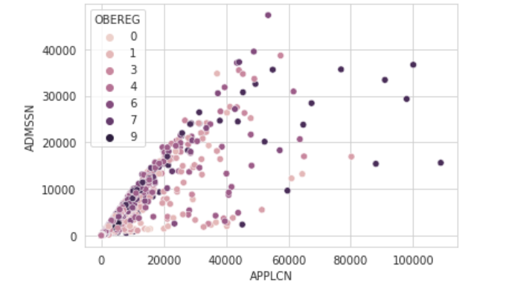
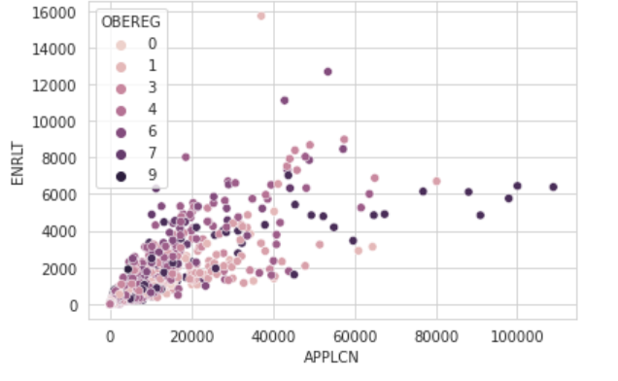

Slide 14
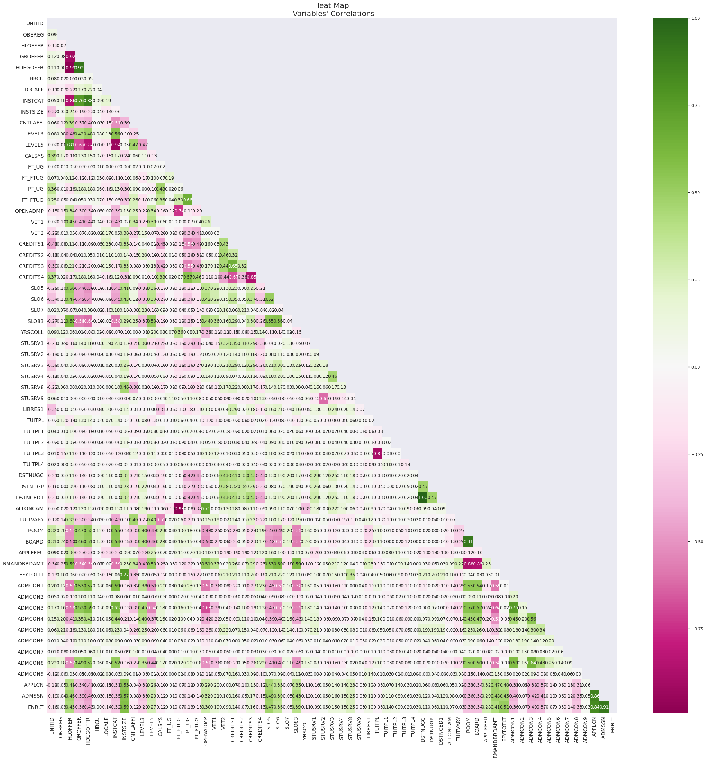

Slide 15
Intended next steps
- Verifying data scales
- Separating out a test set to avoid increasing the models’ bias
- Continue with some additional data visualizations
- Correlation Analysis of the features
- Completing final data preparation to ensure that the ML Algorithms run smoothly (for example using scaling techniques, labeling categorical data, dealing with outliers etc.)
- Select the best ML models (Regression Model; possibly DBSCAN for clustering; Feature Selection optimization via Principal Component Analysis)
-Extracting the shortlisted Institutions’ data across different years

